Slide 1
Programming Fundamentals
Lecture 02: Introduction, History and Basics
Course Instructor:
Mr. Haroon Zafar
Department of Computer Science,
NUCES,Fast Peshawar.

Slide 2
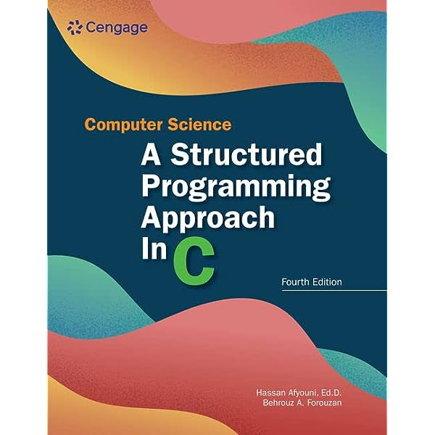
Recommended Book
Computer Science: A Structured Programming Approach Using C
3

Slide 3
Why Programming?
Computers are intended to help people solve problems
from simple vending machines
to doing complex calculations for defense solutions,
to helping man fly to the moon and back.
They are an amazingly useful tool.
But, they're also as dumb as a pile of rocks. By themselves, they only take up space.
By themselves, they are just expensive collections of metal, plastic, and silicon. If that's all they are, how do they do all of the things they do?
The answer is programming.
A programmer writes a program to tell the computer what to do.
A programmer’s job is to take a problem, break it down into a series of steps, and describe those steps to the computer so it can arrive at a solution to the problem.
5

Slide 4
What is Programming?
Programming is the process of taking an algorithm and encoding it into a programming language, so that it can be executed by a computer.
Examples of algorithm
Steps to make tea
Solving a mathematical equation like Area of circle
Searching a student from a list of students
Linear search
Binary Search
6

Slide 5
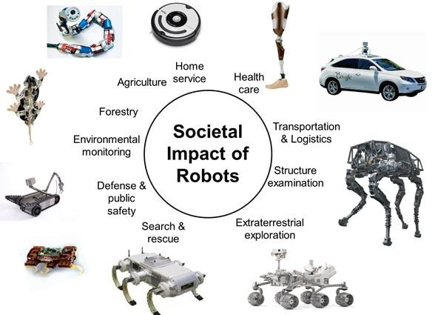
We can do Programming for ..
We can do programming for almost everything
For example, Programs control Robots that do wonderful things for us
7

Slide 6

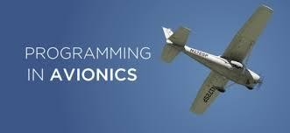
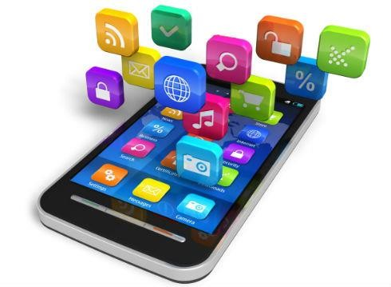

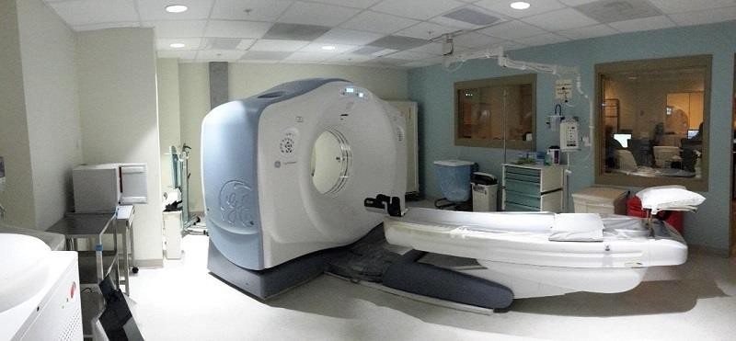
We can do Programming for ...
Programming help us in
designing 3D animated movies
controlling aircrafts
to develop Websites and apps like google maps, Wikipedia,
YouTube etc.
doctors to cure disease by processing huge amount of data
8

Slide 7

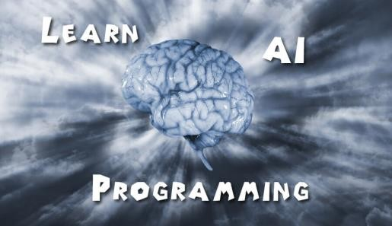
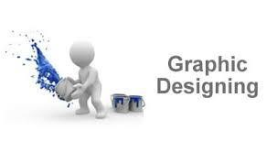
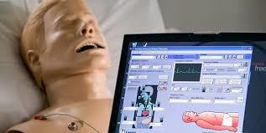
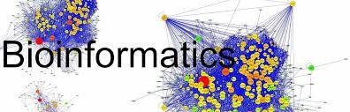
We can do Programming for ...
Some more interesting fields of programming include
Applications of Artificial Intelligence
E-Learning
Graphics & Animation
Simulations
Bioinformatics
Game Programming
9

Slide 8
How do we do programming?
How Software is made
1-10

Slide 9
Computer Languages
Machine language
Only language computer directly understands
Defined by hardware design
Machine-dependent
Generally consist of strings of numbers
Ultimately 0s and 1s
Difficult to understand for humans
Example:
1001110001

Slide 10
Computer Languages
Assembly language
English-like abbreviations representing basic computer operations
Clearer to humans
Not understandable by computers
Translator programs (assemblers)
– Convert to machine language
Example:
LOAD ADD STORE
BASEPAY OVERPAY GROSSPAY

Slide 11
Computer Languages
High-level languages
Closer to everyday English, use common mathematical notations
Single statements accomplish many tasks
Assembly language requires many instructions to perform simple tasks
Translator programs (Compilers)
Convert to machine language
Interpreter programs
Directly execute high-level language programs
Example:
grossPay = basePay + overTimePay

Slide 12
What is a Programming Language?
A vocabulary and set of grammatical rules for instructing a computer to perform specific
tasks

Slide 13
What is a Computer Program?
A computer program (software, or just a program) is a sequence of instructions written to perform a specified task with a computer.
Computer program (source code) is often written by computer
programmers in programming languages (C, C++, java)
Source code
may be converted
a binary)
into an executable file by a compiler and later
(executable program or executed by a CPU.
Alternatively, computer programs may be executed with the aid of an interpreter, or may be embedded directly into hardware.

Slide 14
The Compiler
Compiler is a computer program (or set of programs) that transforms source code written in a programming language into another computer language (machine language, often having a binary form known as object code).
The name "compiler" is primarily used for programs that translate source code from a high-level programming language to a lower level language.
Putting all together

Slide 15
History of C and C++
History of C
Evolved from two other programming languages
BCPL and B
– “Typeless” languages (everything is a word)
Dennis Ritchie (Bell Laboratories)
Added data types, other features
Development language of Linux
Hardware independent
Portable programs
1989: ANSI standard
1990: ANSI and ISO standard published
ANSI/ISO 9899: 1990

Slide 16
History of C and C++
History of C++
Extension of C
Early 1980s: Bjarne Stroustrup (Bell Laboratories)
Provides capabilities for object-oriented programming
Objects: reusable software components
Model items in real world
Object-oriented programs
Easy to understand, correct and modify
Hybrid language
C-like style
Object-oriented style
Both

Slide 17
Introduction to C++
Widely used programming language
Used in professional applications development because of its flexibility and power
Combines the facility for efficient procedural programming that it inherits from C, with a powerful object-oriented programming features
Provides extensive facilities in its standard Library
Ref: http://spectrum.ieee.org/computing/software/the-2016-top-programming-languages http://redmonk.com/sogrady/2016/07/20/language-rankings-6-16/

Slide 18
A Simple C Program
#include <stdio.h>
Preprocessor Directive
int main(){
printf(“Assalamualikum!”);
return 0;
}//end of the main

